Slide 1
TBD: Precise and Practical Sampling-based Side channel Information Leakage Quantification
Bao Qinkun

Slide 2


What is a side-channel attack ?
Wikipedia: A side-channel attack is any attack that allows attackers to infer some sensitive information based on non-functional characteristics.
A naïve Ph.D. student
A prestigious professor
Notes:
Side-channel attacks allow attackers to infer some sensitive information based on non-functional characteristics.
But the definition is a little boring.

Slide 3
Side-channel attacks
Secret: whether your advisor is in the office
What you can do:
Ask your advisor (Not a good idea)
Attacker
Victim

Slide 4
Side-channel attacks
Secret: whether your advisor is in the office
What you can do:
Ask your advisor (Side effect)
Insight:
Your advisor always drives to work.
The parking lot is shared with you.

Slide 5

Side-channel attacks
Secret: whether your advisor is in the office
What you should do:
Go to the parking lot
Find your advisor's vehicle

Slide 6
Address-based Side Channels
Side-channels in computer systems: timing, power, CPU usage, cache …
unsigned char key = input();
// 4 bits information
unsigned char temp = key/2; if (temp = 0xb) // branch 0 execution 2s else // branch 1 execution 1s
T[1024];
// Lookup tables with 1024 entries index = key % 1024; temp = T[index]
// Secret-dependent memory access
Secret-dependent control-flow transfers (CF)
Secret-dependent memory accesses (DATA)
Cache-based: Prime + Probe, Flush + Reload, Flush + Evict
Memory-based: Controlled-channel attack, page-table attack

Slide 7
Side-channel Vulnerability Detections
Software countermeasures
Find vulnerabilities
It’s hard. Real cryptosystems are complicated
Those vulnerabilities are architecture-dependent
Existing works: CacheAudit, CacheD, DATA, CacheS
Fix vulnerabilities
It’s also hard. Side-channel vulnerabilities are inevitable.
Many vulnerabilities are unpatched.

Slide 8
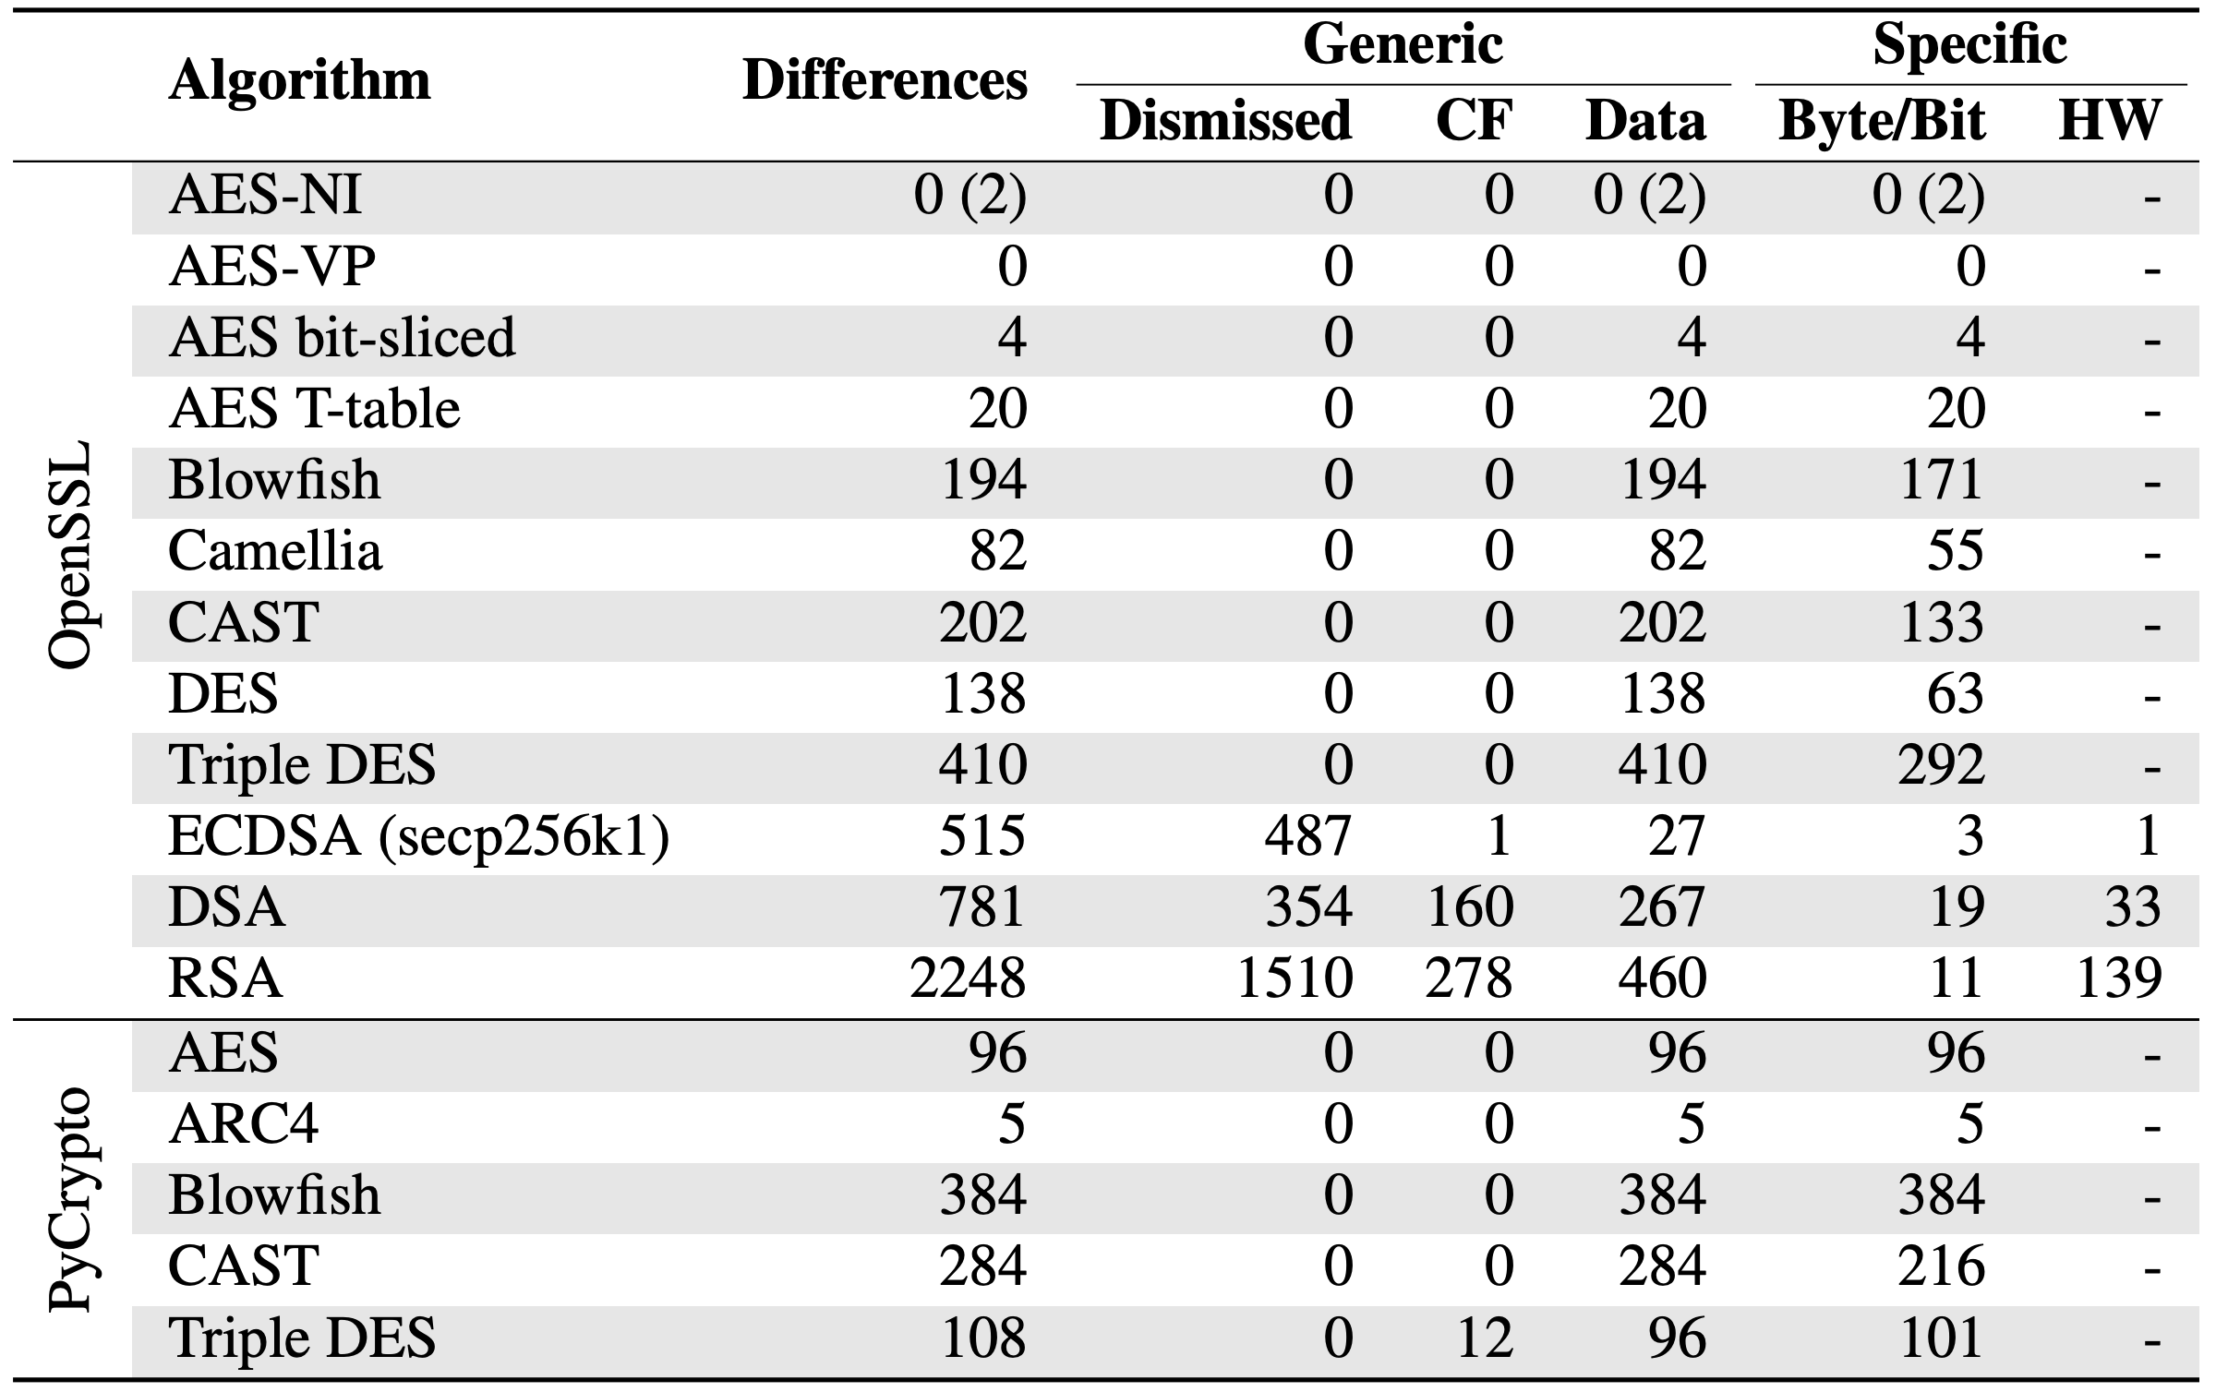
Motivation
S.Weiser,A.Zankl,R.Spreitzer,K.Miller,S.Mangard,andG.Sigl.
DATA - Differential Address Trace Analysis: Finding Address-based Side-Channels in Binaries. In USENIX Security, 2018.
Table 1. Leakage summary of algorithms

Slide 9
Motivation
Existing works:
False positives
e.g., 2248 potential leakages for RSA in OpenSSL, 1510 of them were dismissed
Report many insensitive leakages
Only on one leakage site
Existing work
2 important vulnerabilities
The application
1000 leakage sites
998 unimportant leakages
Our Objective: Identify and quantify address-based side-channels precisely.

Slide 10
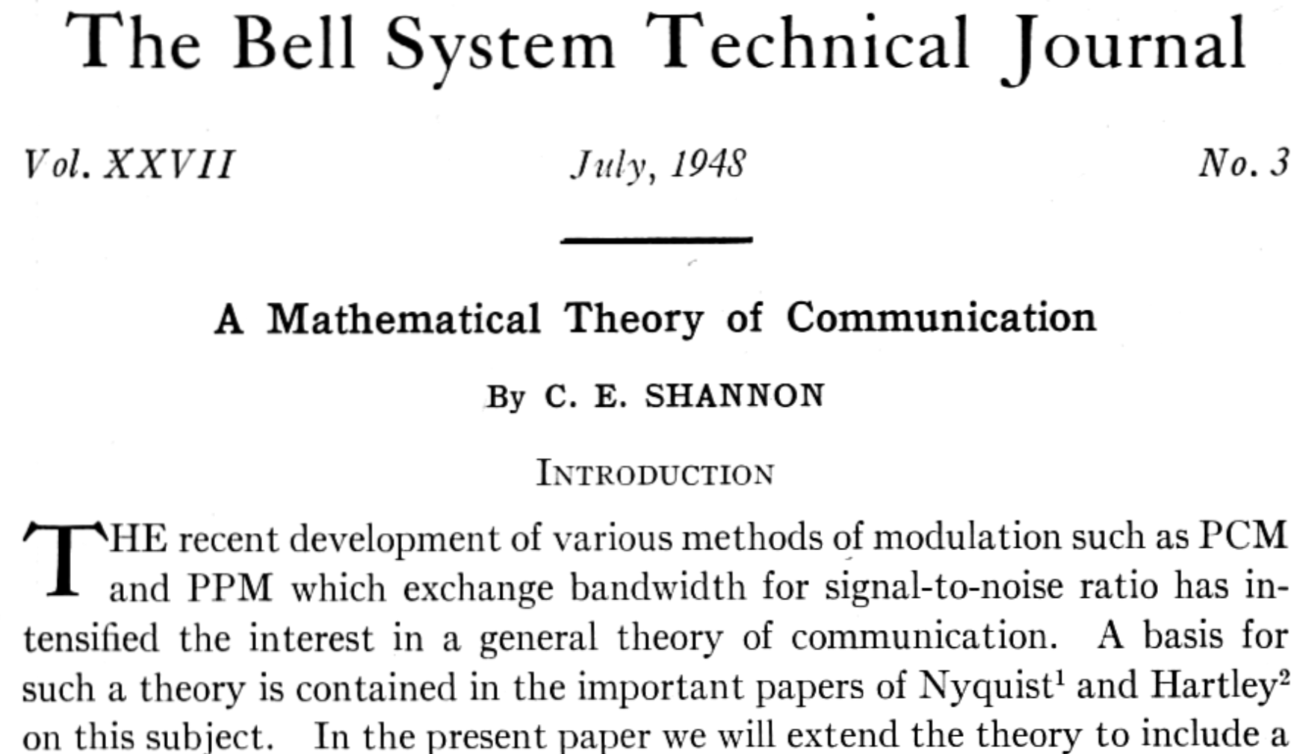
Quantification
Information Theory

Slide 11


Eight Apples
Secret: which apples is poisonous?

Slide 12
Eight Apples
000
001
010
011
100
101
110
111
Secret: which apples is poisonous?

Slide 13
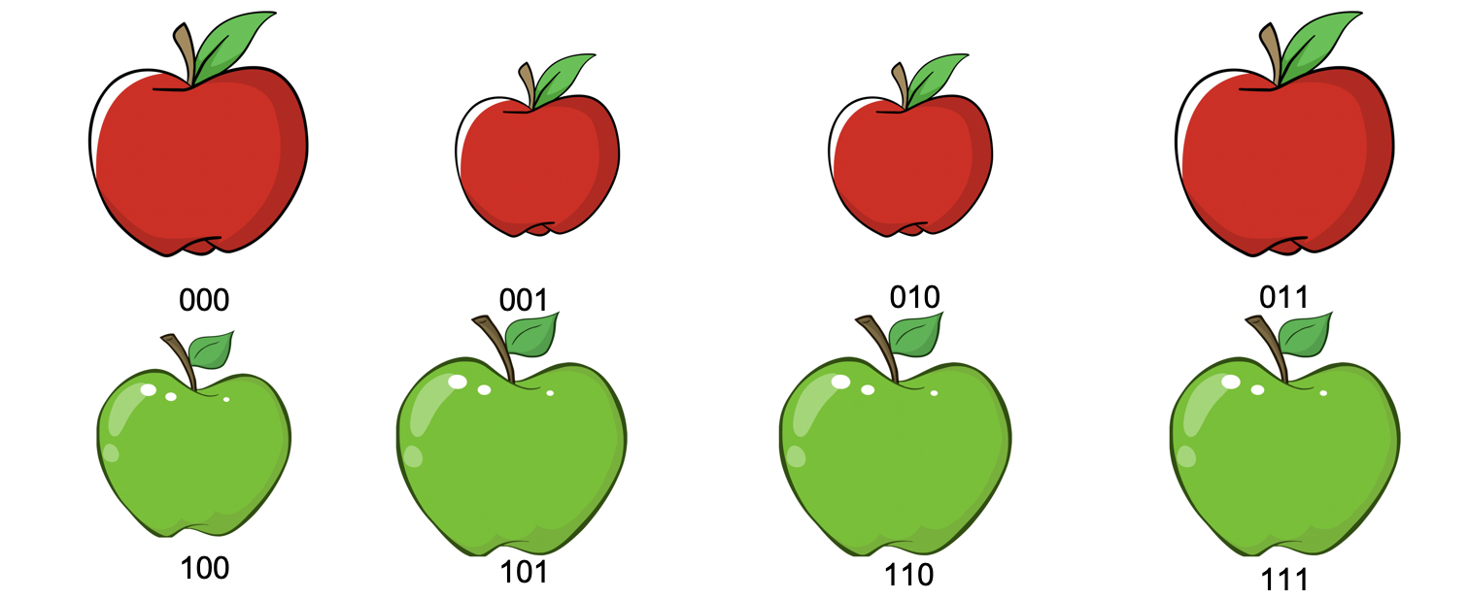
Eight Apples
Secret:
Which apple is poisonous?
Before:
Each apple can be poisonous.
So we have 3 bits information.

Slide 14
Eight Apples
Secret:
Which apple is poisonous?
Before:
Each apple can be poisonous.
So we have 3 bit information.
Clue 1:
The poisonous apple is green.
Only four apples can be poisonous.
So we have 2 bit information.
Leaked = 3 bit – 2 bit = 1 bit

Slide 15
Eight Apples
Secret:
Which apple is poisonous?
Before:
Each apple can be poisonous.
So we have 3 bit information.
Clue 1:
The poisonous apple is green.
Only four apples can be poisonous.
So we have 2 bit information.
Leaked = 3 bit – 2 bit = 1 bit

Slide 16
Eight Apples
Secret:
Which apple is poisonous?
Before:
Each apple can be poisonous.
So we have 3 bit information.
Clue 1:
The poisonous apple is green.
Only four apples can be poisonous.
So we have 2 bit information.
Leaked = 3 bit – 2 bit = 1 bit
Clue 2:
The poisonous apple is small.
Number 100 apple is poisonous.

Slide 17
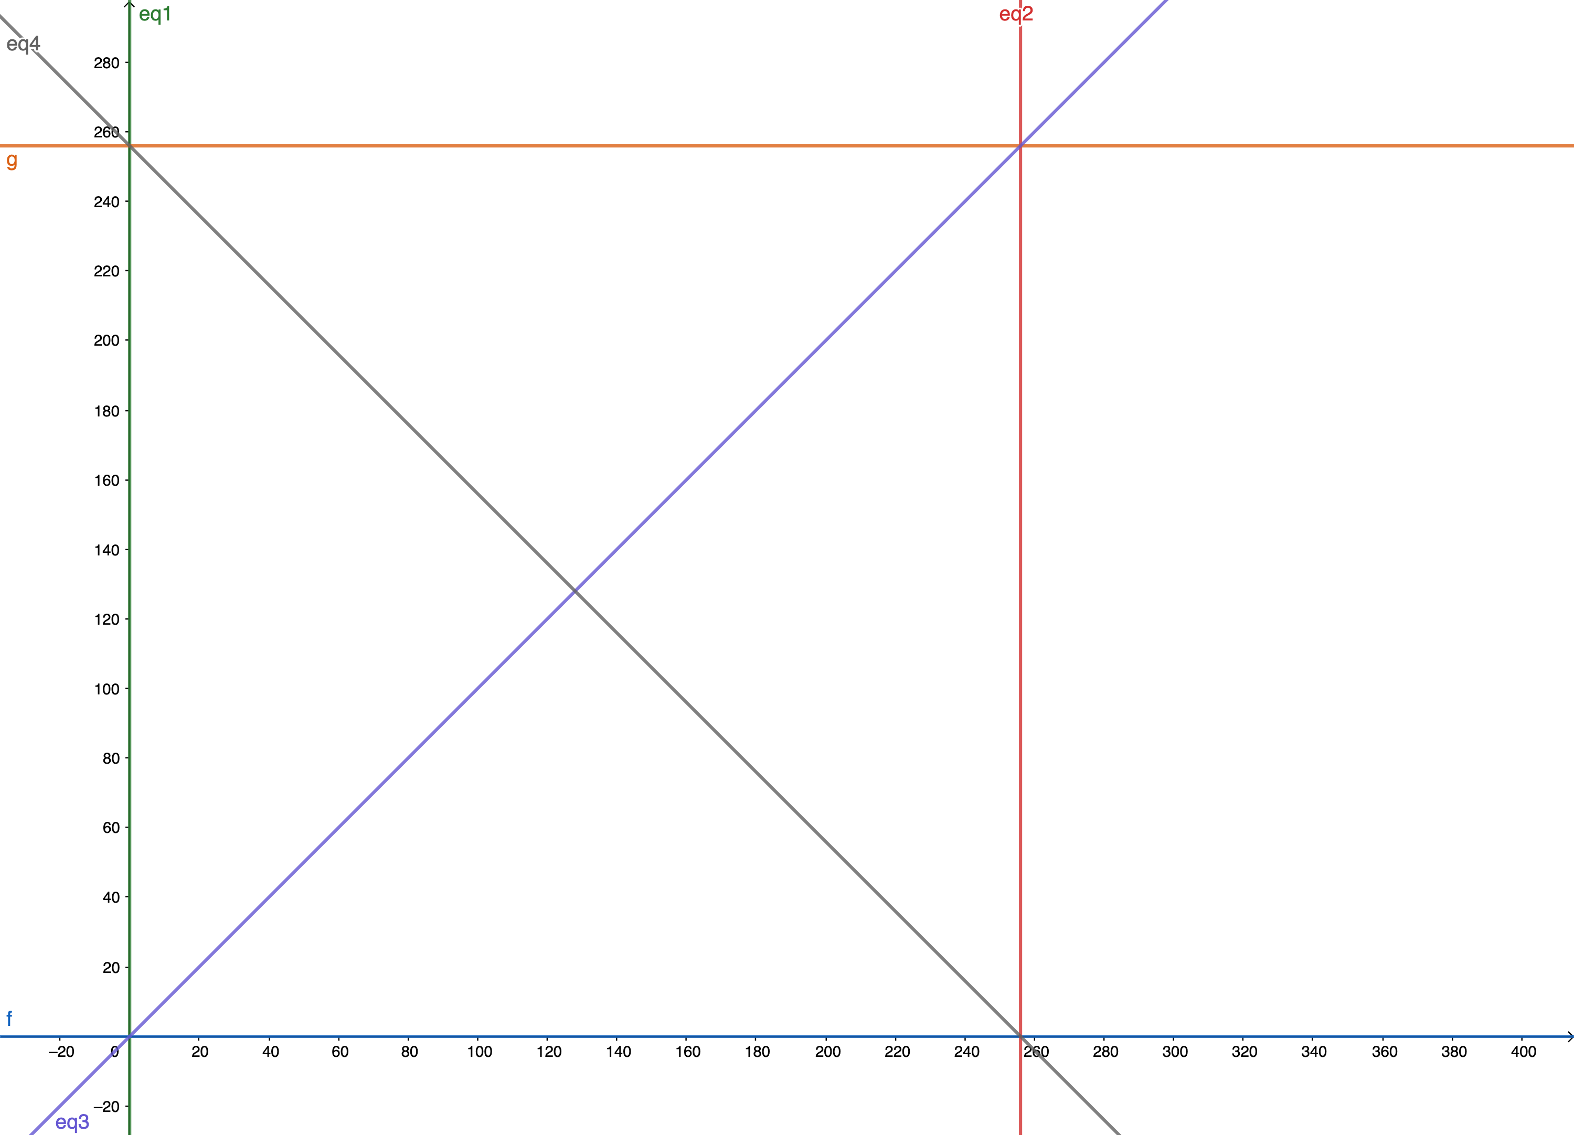
An example
Secret:
The value of k1 and k2
Before:
k1 and k2 can be any value from 0~255
Clue 1: k1 - k2 > 0
Clue 2: k1 + k2 < 256
unsigned char k1, k2;
if(k1 - k2 > 0) // Leakage 1
A();
if(k2 + k1 < 256) // Leakage 2
B();
An attacker:
knows the code runs A(), B()

Slide 18
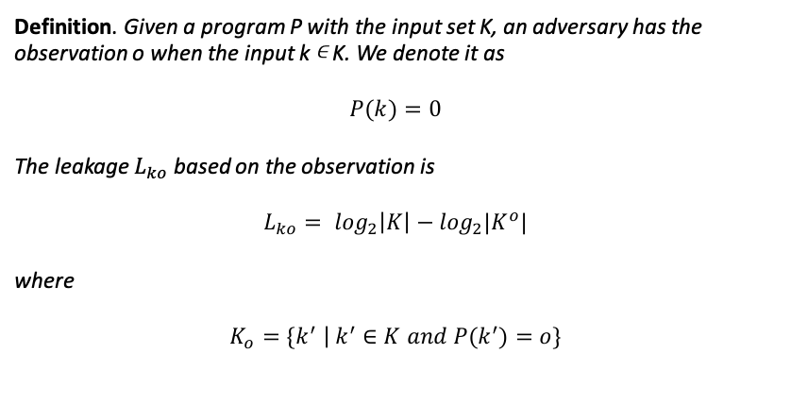
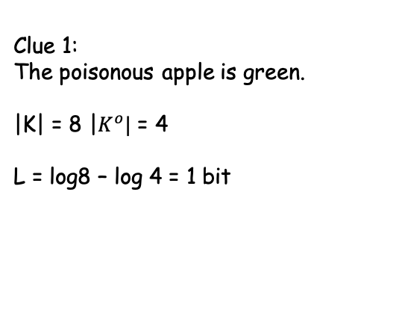
Information Leakage Definition
Definition. Given a program P with the input set K, an adversary has the observation o when the input k ∊ K. We denote it as
$$P\left(k\right)=0$$
The leakage $L_{ko}$ based on the observation is
$$L_{ko}= \log_{2}\left|K\right|−\log_{2}|K^{o}|$$
where
$$K_{o}=\left\{k^{′} \right| k^{′}∈K and P\left(k^{′}\right)=o\}$$
Clue 1:
The poisonous apple is green.
|K| = 8 |$K^{o}|$ = 4
L = log8 – log 4 = 1 bit
Basic idea: counting the number of observations that have the same memory-access pattern.

Slide 19
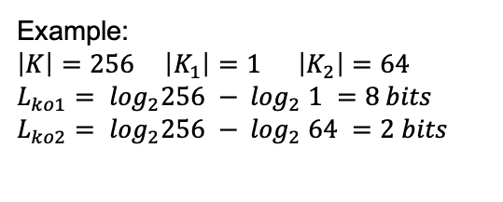
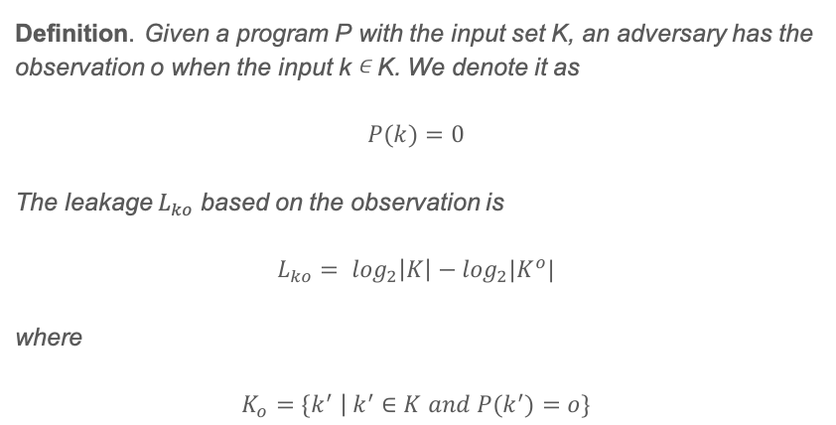
Information Leakage Definition
Definition. Given a program P with the input set K, an adversary has the observation o when the input k ∊ K. We denote it as
$$P\left(k\right)=0$$
The leakage $L_{ko}$ based on the observation is
$$L_{ko}= \log_{2}\left|K\right|−\log_{2}|K^{o}|$$
where
$$K_{o}=\left\{k^{′} \right| k^{′}∈K and P\left(k^{′}\right)=o\}$$
// Dummy password checker
unsigned char key = input(); // key = [0 ... 255] if(key = 128) A(); // branch 1 else if (key < 64) B(); // branch 2 else if (key < 128) C(); // branch 3 else D(); // branch 4
Example:
$\left|K\right|=256$ $\left|K_{1}\right|=1 \left|K_{2}\right|=64$
$$L_{ko1}= \log_{2}256 − \log_{2} 1 =8 bits$$
$$L_{ko2}= \log_{2}256 − \log_{2} 64 =2 bits$$
Basic idea: counting the number of observations that have the same memory-access pattern.

Slide 20
Overview
8048d60 push ebp 8048d61 mov ebp, esp 8048d63 push ebx 8048d64 sub esp, 0x14 8048d67 mov eax, dword ptr [ebx] 8048d6c test eax, eax
...
t1 = f1(k1, k2, k3, k4, …, kn)
t2 = f2(k1, k2, k3, k4, …, kn)
t3 = f3(k1, k2, k3, k4, …, kn)
t4 = f4(k1, k2, k3, k4, …, kn)
t5 = f5(k1, k2, k3, k4, …, kn)
…
tm = fm(k1, k2, k3, k4, …, kn)
Symbolic Execution
Trace logging
Program
Key
f1(k1, k2, k3, k4, …, kn) > 128
f4(k1, k2, k3, k4, …, kn) mod 64 ≡ 10
f1(k1, k2, k3, k4, …, kn) > 128
f4(k1, k2, k3, k4, …, kn) mod 64 ≡ 10
f5(k1, k2, k3, k4, …, kn) = 0
…
fk(k1, k2, k3, k4, …, kn) = 1
Leakage Report
Monte Carlo
Sampling
f5(k1, k2, k3, k4, …, kn) > 128
fk(k1, k2, k3, k4, …, kn) = 1
Figure 1. TBD architecture

Slide 21
Challenges
Information Leakage Definition
Existing work: Shannon entropy and mutual information
Number of different observations
Leakage Dependence
Real-world applications may have multiple information leakages sites
Some leakages are dependent
Scalability
We want to quantify information leakages in real-world applications
e.g. RSA implementations OpenSSL have thousands of lines -> 1 million instructions
The performance is important

Slide 22

Challenge 1: Information Leakage Definition
Program (P)
Observation (O)
Key (K)
Figure 2. Observation Model
Observations:
Secret-dependent control-flow transfers
Secret-dependent memory access

Slide 23
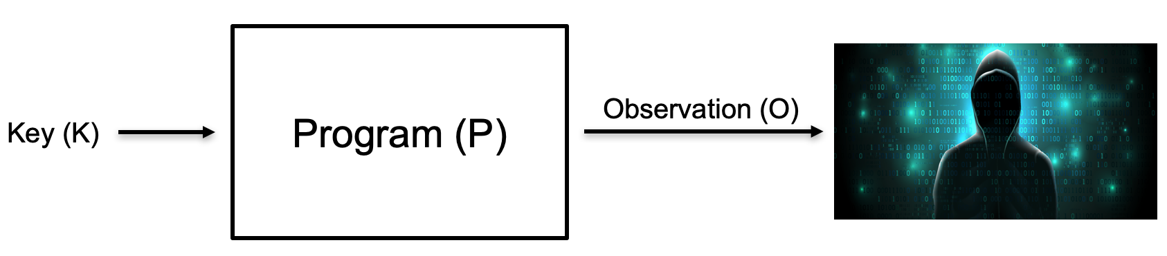
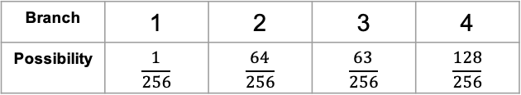
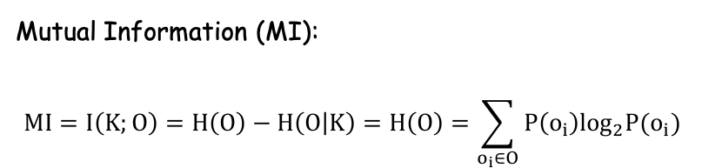
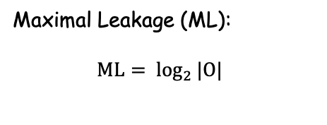
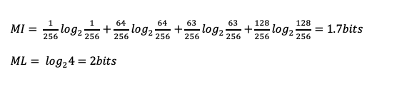
Previous Information Leakage Definition
Mutual Information (MI):
$$MI=I\left(K;O\right)=H\left(O\right)−H\left(O | K\right)=H\left(O\right)=\sum_{o_{i}∈O}{P\left(o_{i}\right)\log_{2}P(o_{i})}$$
unsigned char key = input(); // key = [0 ... 255] if(key = 128) A(); // branch 1 else if (key < 64) B(); // branch 2 else if (key < 128) C(); // branch 3 else D(); // branch 4
Maximal Leakage (ML):
$$ML= \log_{2 }|O|$$
Branch | 1 | 2 | 3 | 4
Possibility | $$\frac{1}{256}$$ | $$\frac{64}{256}$$ | $$\frac{63}{256}$$ | $$\frac{128}{256}$$
$MI= \frac{1}{256}\log_{2}\frac{1}{256}+\frac{64}{256}\log_{2}\frac{64}{256}$ $+\frac{63}{256}\log_{2}\frac{63}{256}$ $+\frac{128}{256}\log_{2}\frac{128}{256}=1.7bits$
$$ML= \log_{2}4=2bits$$

Slide 24
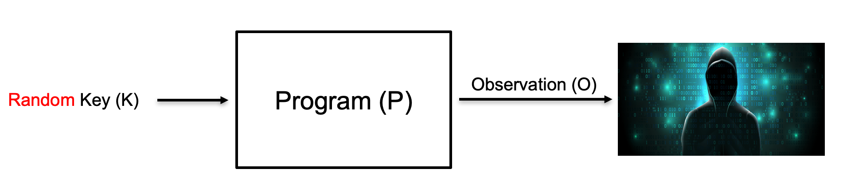
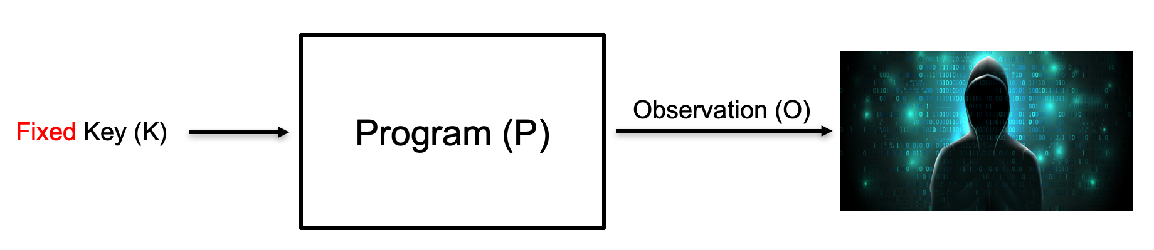
Challenge 1: Information Definition
// Dummy password checker
unsigned char key = input(); // key = [0 ... 255] if(key = 128) A(); // branch 1 else if (key < 64) B(); // branch 2 else if (key < 128) C(); // branch 3 else D(); // branch 4
Suppose an attacker knows the code run branch 1, then he knows the key equals to 128.
Mutual Information: 1.7 bits
Max Leakage: 2 bits
Problem: Both methods neglect the input key and give an “average” estimate.
Figure 3. Mutual Information
Figure 4. Real Attack

Slide 25
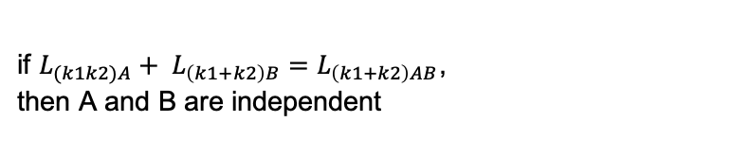
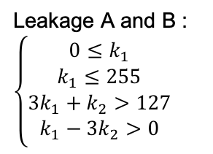
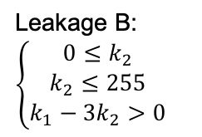
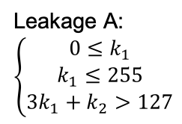
Challenge 2: Leakage Dependence
Suppose one program has two leakage sites A and B.
Independent Leakage
Mutual Exclusive Leakage
Dependent Leakage
Leakage A:
$$\left\{\begin{aligned}0{≤k}_{1} \\ k_{1}≤255 \\ 3k_{1}+k_{2}>127\end{aligned}\right.$$
Leakage B:
$$\left\{\begin{aligned}0{≤k}_{2} \\ k_{2}≤255 \\ k_{1}−{3k}_{2}>0\end{aligned}\right.$$
Leakage A and B :
$$\left\{\begin{aligned}0{≤k}_{1} \\ k_{1}≤255 \\ 3k_{1}+k_{2}>127 \\ k_{1}−{3k}_{2}>0\end{aligned}\right.$$
unsigned char k1, k2, t1, t2; t1 = k1 + 2*k2; t2 = 2*k1 - k2; if(t2 + t1 > 127) // leakage A A(); if(t2 - t1 > 0) // leakage B B();
if $L_{(k1k2)A}+ L_{\left(k1+k2\right)B}=L_{\left(k1+k2\right)AB}$,
then A and B are independent

Slide 26
Challenge 3: Scalability
We want to quantify information leakages from real-world applications.
The performance suffers from the following aspects:
Symbolic Execution
IR explosion
Monte Carlo Sampling
#P problem

Slide 27
Challenge 3: Scalability (Symbolic Execution)
Why symbolic execution (SE) is slow?
Path Explosion
Constraint Solving
Intermediate Languages (IR)
STR R_EAX:32, , V_00:32 STR 0:1, , R_CF:1 AND V_00:32, ff:8, V_01:8 SHR V_01:8, 7:8, V_02:8 SHR V_01:8, 6:8, V_03:8 XOR V_02:8, V_03:8, V_04:8 SHR V_01:8, 5:8, V_05:8 SHR V_01:8, 4:8, V_06:8 XOR V_05:8, V_06:8, V_07:8 XOR V_04:8, V_07:8, V_08:8 SHR V_01:8, 3:8, V_09:8 SHR V_01:8, 2:8, V_10:8 XOR V_09:8, V_10:8, V_11:8 SHR V_01:8, 1:8, V_12:8 XOR V_12:8, V_01:8, V_13:8 XOR V_11:8, V_13:8, V_14:8 XOR V_08:8, V_14:8, V_15:8 AND V_15:8, 1:1, V_16:1 NOT V_16:1, , R_PF:1 STR 0:1, , R_AF:1 EQ V_00:32, 0:32, R_ZF:1 SHR V_00:32, 1f:32, V_17:32 AND 1:32,V_17:32, V_18:32 EQ 1:32,V_18:32, R_SF:1 STR 0:1, , R_OF:1
✔
✔
?
Why symbolic execution uses IR?
Support many architecture platform.
X86, ARM, MIPS
Easy to implement
X86, more than 1000 instructions
Side effects
test eax, eax
QSYM: A Practical Concolic Execution Engine Tailored for Hybrid Fuzzing. Insu Yun, Sangho Lee, Meng Xu, Yeongjin Jang, and Taesoo Kim.In Proceedings of the 27th USENIX Security Symposium (Security 2018),Baltimore, MD, August 2018.
Solution: instruction-level symbolic execution

Slide 28
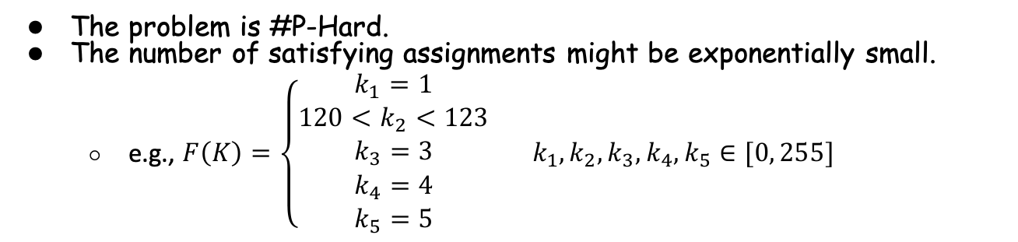

Challenge 3: Scalability (Monte Carlo Sampling)
The problem is #P-Hard.
The number of satisfying assignments might be exponentially small.
e.g., $F\left(K\right)=\left\{\begin{aligned}k_{1}=1 \\ {120<k}_{2}<123 \\ k_{3}=3 \\ k_{4}=4 \\ k_{5}=5\end{aligned} k_{1},k_{2},k_{3},k_{4},k_{5}∈[0, 255]\right.$
Total search space: $2^{40}$
Only two satisfying assignments
Solution: Split the constraint into several independent small groups
Notes:
We run Monte Carlo sampling method n times and we find m satisfying solutions, let p = m/n, we can prove that as long as n > 8/p, we have 95% confidence that the error is within 1 bit.

Slide 29
Implementation
16k LoC of C++11
Trace Collection
Intel Pin Tool
Symbolic Execution
arithmetic, bitwise, logical, control-transfer
Not support: AVX, floating number, AES-NI
Information Leakage Computation
Data flow analysis
Debug Information Parser

Slide 30
Evaluation (Not finished)
Real-world cryptosystems:
OpenSSL 0.9.7 1.1.1
mbedTLS 2.5 2.15
Libjpeg
Performance
8s found 8 secret-dependent memory access for the DES in mbedTLS 2.5

Slide 31
Demo

Slide 32
Summary
Identify and quantify address-based side-channels leakages precisely
A trace-based method that models each leakage site with math formulas.
We quantify the information leakages based on the number of secrets that satisfy the constrain.
Most of leakages found by recent works are hard to be exploited. (Need to be confirmed)

